Slide 1
New Director Training
Virtual Format

Slide 2
MODULE
SEVEN
Fiscal
Responsibilities
For
Compliance to
WIOA

Slide 3
The Big Picture
Fiscal Overview

Slide 4
Making Sense of the Laws & Regulations for Fiscal Management of Adult Education
AEFLA (Program Status)
EDGAR (Education Department General Administrative Regulations)
OMB Uniform Guidance (Government-wide)
Why Three Sources?
After Congress passes legislation, OMB often interprets the law’s main requirements, which provides guidance to federal and state agencies. Then individual federal agencies can further refine and regulate requirements, as the Department of Education has done in EDGAR.
Legislation
OMB Guidance
Regulation (EDGAR)

Slide 8
AEFLA Grants: State Matching
State Match-
25%
Notes:
States are required to provide a 25% match to federal grant awards. Typically, Wyoming has used State appropriations for Adult Education. However, with the reduction in State funds it is critical that all local providers in Wyoming submit documentation for local matching funds. Local match fund amounts, submitted with year end reports (see subsequent slide) are then used to meet the 25% requirement.

Slide 9
The Local Picture
Fiscal Responsibilities in Wyoming’s AE Programs

Slide 10
AE Funding Flow Chart
U.S. Dept. of Education (OCTAE)
Wyoming Community College Commission (SEA for Federal & State AE Grants)
Adult Education Grants ABE, ASE, ESL, Corrections
IELCE
Leadership

Slide 11
Grant Awards
IELCE
Federal
State
All other AE programming: ABE, ASE, Corrections, IET, Leadership, Family Literacy, Bridge/Transitions, Workplace Literacy, Career Services, etc.
Notes:
The Wyoming SEA has fiscal responsibility for both Federal and State appropriated grants. Federal funds come from the U.S. Department of Education (OCTAE) while State funds are appropriated by the Wyoming legislature.
In Wyoming, Adult Education Federal and State grant fund are utilized to support all local programming, except IELCE which is exclusively federal funding.
Across the United States, Wyoming receives the lowest amount of federal funds for any State. Consequently, many AE programs in Wyoming are VERY limited in what they can offer simply due to a lack of available funds.

Slide 12
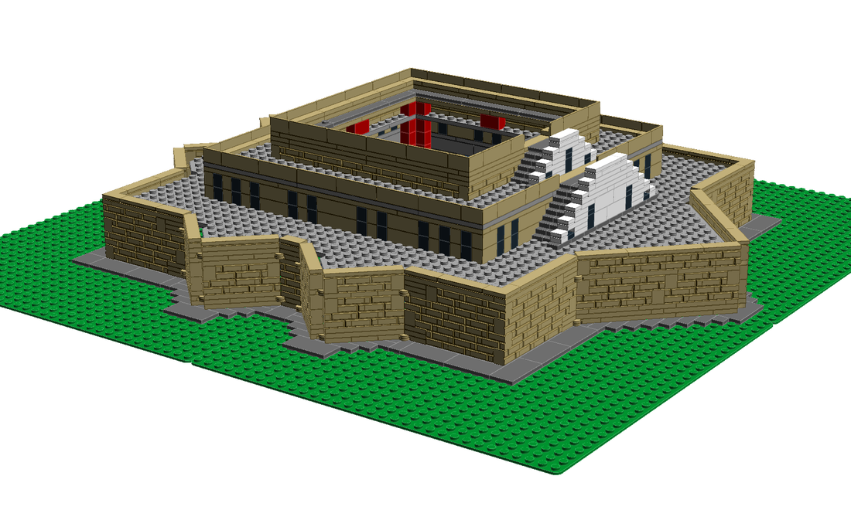
The Funding Formula
State & Federal AE Grant funds
AWARDS
BASE
Census Data
Enrollments
Outreach
Corrections
Completions
Targets
$70,000
PBF
Notes:
Both federal and state grant funds are utilized in Wyoming’s funding formula.
Wyoming’s Adult Education program utilizes a performance based funding formula in the distribution of funds. There are several components to the funding formula which are NOT based upon performance and rely upon other program/regional factors such as census data, outreach sites, total enrollments, and corrections education. In addition, each approved provider is awarded $70,000 in base funding as a means to help stabilize funding in times when there are funding shortfalls.
Performance based funding includes how well the program met targets at each educational functioning level in the previous year as well as the number of completions.
Awarded amounts use both base and performance based funding.
A copy of the model is available upon request to local providers.

Slide 13
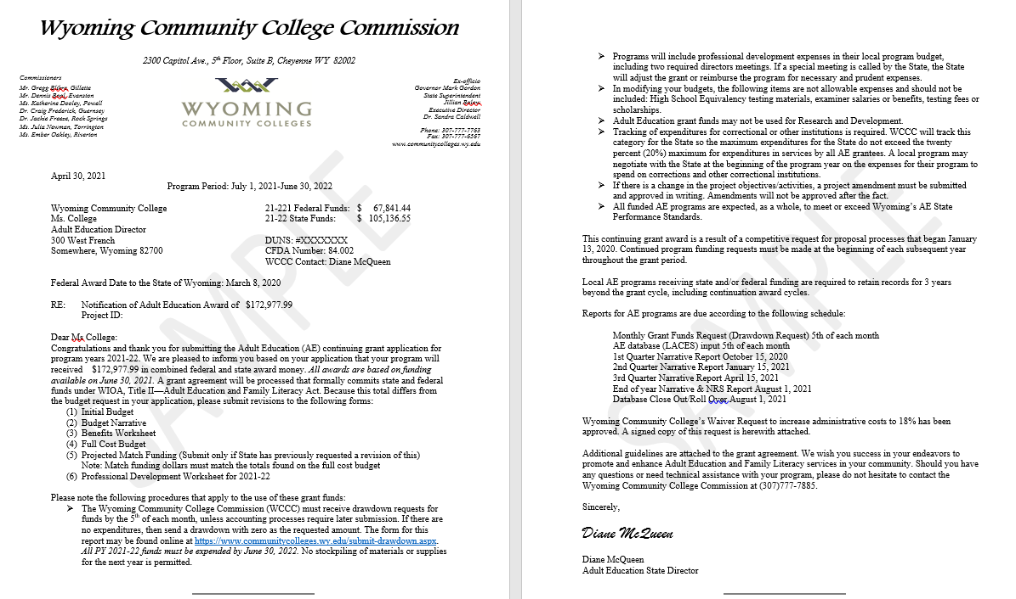
The Award Letter
May/June
Amounts to be awarded
Grant stipulations
Due dates
Notes:
Award documents are typically made in May/June after the SEA knows how much federal and state allocations to Adult Education will be.
Award letters state the amount of federal and state funds to be received.
They outline grant stipulations and due dates of various reports throughout the year.

Slide 14
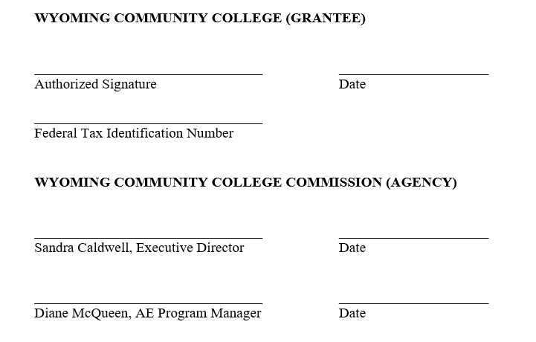
The Grant Agreement
Parties
Purpose of Agreement
Terms
Payment
Responsibilities of Grantee
Responsibilities of the Agency (SEA)
Special Provisions
General Provisions
Notes:
A grant agreement is sent to all approved providers after an award letter has been sent. The grant agreement outlines the terms of the grant in much more detail than the award letter and serves as a contract between the grantee and the Wyoming Community College Commission.
Items covered in the agreement include:
1) who the grant is between (i.e. the Parties).
2) The Purpose of the Agreement outlines what the grant is for.
3) Terms of Agreement and Required Approval details the dates for which the grant is valid
4) The Payment portion of the GA has many sub-sections which include such things as how reimbursements are to be made, due dates in which drawdowns must be submitted, how a drawdown is to be submitted, and other items relating to payment.
5) The Responsibilities of the Grantee discusses the type of individual that can be served, allowable instructional activities, assessment information, data collection, referrals, professional development, the use of evidence-based literacy instructional materials in classrooms, and other responsibilities of the grantee as mandated by federal and state protocols.
6) Responsibilities of the Agency include items on the provision of technical assistance, data matching, monitoring, and other required mandates.
7) The Special Provisions section outlines the use of the LACES database, auditing, performance, restrictions for funding corrections, EDGAR provisions, program income, purchasing restrictions, report due dates for the year, site visits, and other federal requirements of an AE grant
8) The General Provisions sections reviews the availability of funds, SEA access to local provider grant records, and other legal requirements for the grant.
The grant is not valid until it is signed by all parties.

Slide 15
Allowable vs. Non-allowable Costs
Factors Affect Cost Allowability
Reasonable: incurred by a prudent person, and necessary for the performance of the grant.
Allocable: charged in accordance with benefits received, proportional.
Authorized: AEFLA, Uniform Guidance, EDGAR, state or local laws and regulations.
Adeqately document.
RAAA!

Slide 16
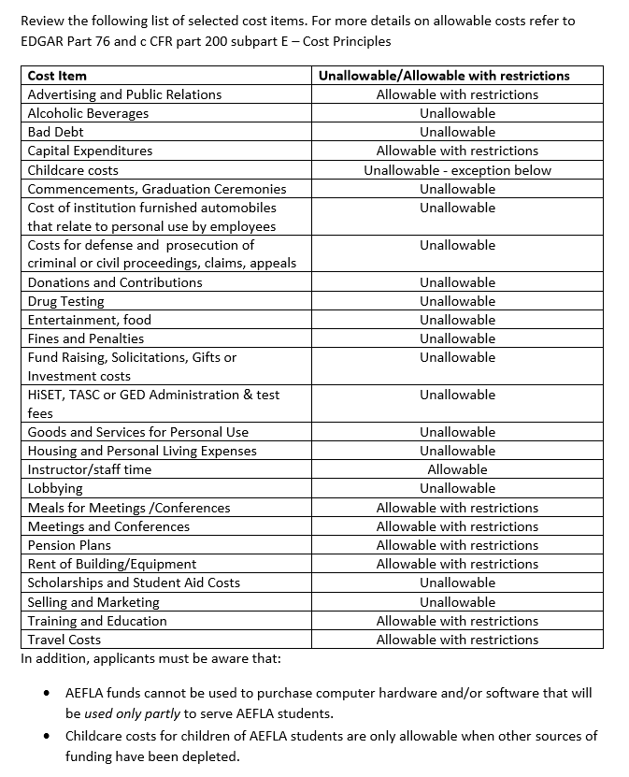
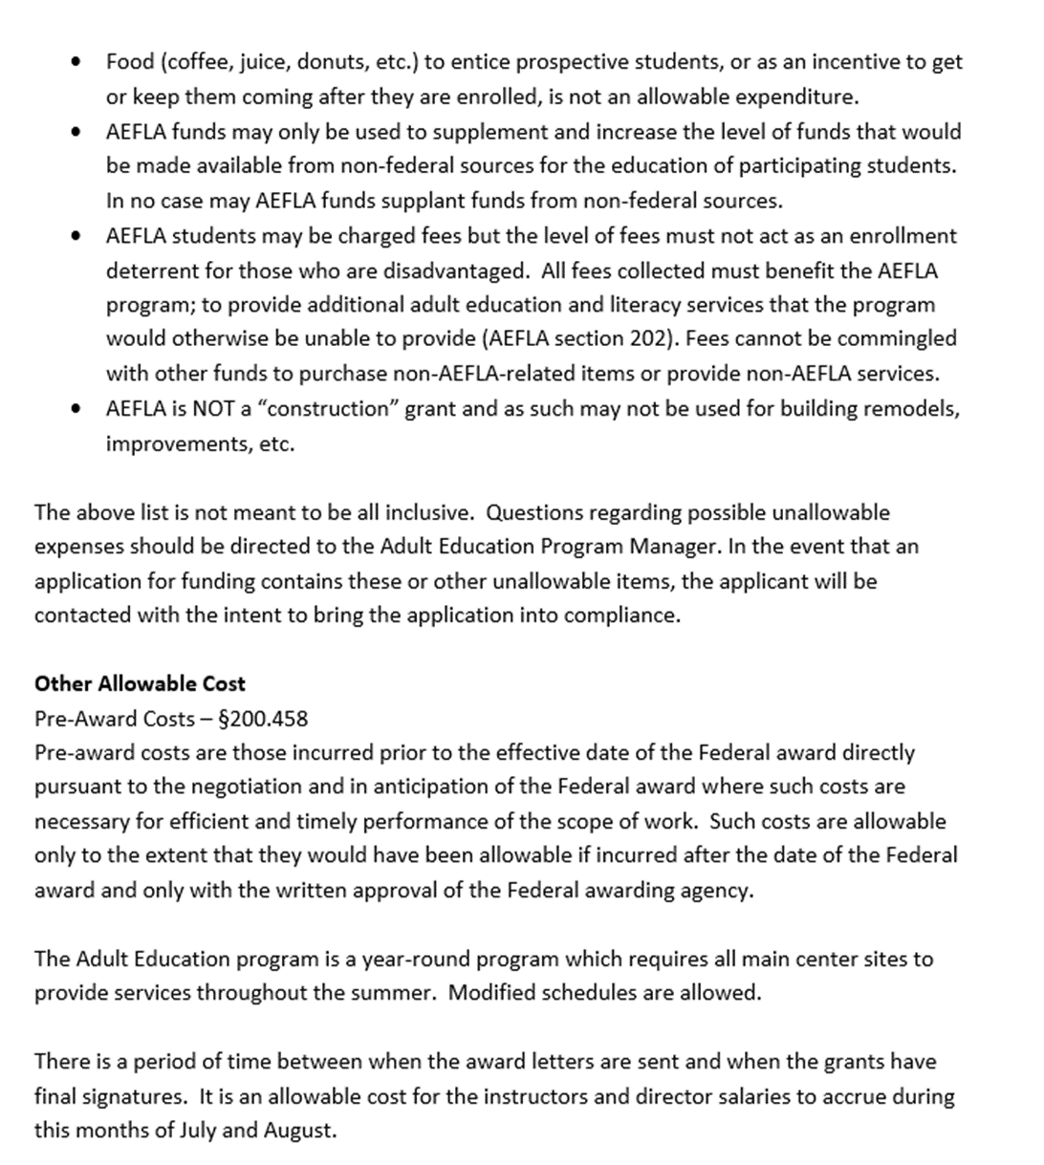

Slide 17
Supplement not Supplant
Federal funds may NOT be used to pay for services, staff, programs, or materials that would otherwise be paid with state or local funds.
Notes:
AEFLA Section 241(a) mandates: “Funds made available for AEFLA activities under this title shall supplement and not supplant other State or local public funds expended for adult education and literacy activities.”
In accordance with WIOA Title II (Sec. 241), funds made available for adult education and literacy activities under the AE grant in Wyoming shall supplement and not supplant other State or local public funds expended for adult education and literacy activities.

Slide 18
Supplement Not Supplant (Continued)
Supplanting would be presumed in these situation:
Federal funds used to provide services that were supported by state or local funds in the prior year.
Federal funds used to provide services the State or local provider is required to make available under other federal, state, or local laws.

Slide 19
Waiver for Administrative Costs
Notes:
WIOA Section 233 states that at least ninety-five percent (95%) of an eligible recipient’s federal grant award must be expended for adult education and literacy activities and the remaining amount, not to exceed 5%, shall be used for planning, administration (including carryout out the requirements of section 116), professional development, and the activities described in paragraphs (3) and (5) of section 232.
In cases where the cost limits described above are too restrictive to allow for the activities described in subsection (a)(2), the eligible provider shall negotiate with the State in order to determine an adequate level of funds to be used for non-instructional purposes. This must be completed by submitting a ‘Waiver Request to Increase Administrative Costs (See next slide). The WCCC will use this to initiate the negotiation of the new percentage.

Slide 20
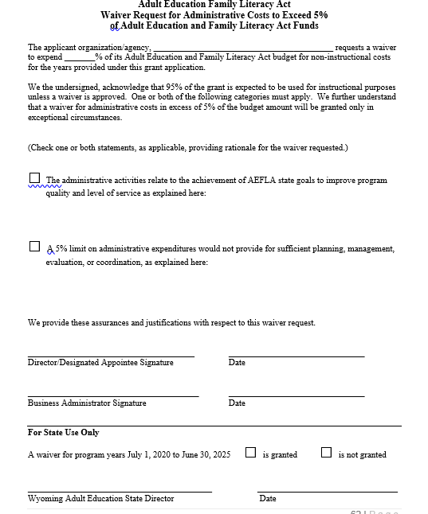
The Waiver
Is part of the competitive grant competition
Valid for length of grant
Notes:
A Waiver to increase the WIOA restriction of 5% of expenditures on Administration, planning, and professional development is submitted with all new competitive grant applications and is valid for the length of the grant or unless otherwise changed/modified by the State.

Slide 21
Indirect Costs
Defined (2 CFR §200.56)
Costs incurred for a common or joint purpose benefitting more than one cost objective, and not readily assignable to the cost objectives specifically benefitted, without effort disproportionate to the results achieved.
A guide to indirect costs can be found here.
EXAMPLES:
Business office functions, including accounting & finance
Human resource functions
Computer hardware (General purpose)
Facilities costs (space rental, utilities, etc.
Maintenance
Notes:
AEFLA is a restricted indirect cost grant. That means that the maximum is 8.5% is the restricted rate for AEFLA programs.
What are indirect costs?
Indirect costs represent the expenses of doing business that are not readily identified with a particular grant, contract, project function or activity, but are necessary for the general operation of the organization and the conduct of activities it performs. In theory, costs like heat, light, accounting and personnel might be charged directly if little meters could record minutes in a cross-cutting manner. Practical difficulties preclude such an approach. Therefore, cost allocation plans or indirect cost rates are used to distribute those costs to benefiting revenue sources.
Looking at it another way, indirect costs are those costs that are not classified as direct. Direct costs can be identified specifically with particular cost objectives such as a grant, contract, project, function or activity.
Wyoming’s AE programs seldom use this category for budgeting purposes as most costs are considered direct cost activities.

Slide 22
Collecting Fees & Registration
General Accounting Rules & Information:
Fees collected cannot be added to a general fund
Fees collected must be re-spent within the year in which they were collected AND
May only be spent on allowable AEFLA activity

Slide 23
Program Income
EDGAR: 34 CFT 80.25 & 34 CFR 76.534
Restrictions & Requirements
Program income can only be spent on current costs on allowable AEFAL activities
Program income must be used with the program year in which it was collected.
Income collected cannot provide a barrier to enrollment
Program income may not be used as a local match to the program or maintenance of effort
Local programs are required to account for program income on year end FSR’s
Income taken in as a direct result of allowable activities provided under this grant
Notes:
Program income is defined as gross income received by the grantee or sub-grantee directly generated by a grant supported activity, or earned only as a result of the grant agreement during the grant period. Funds so earned may be added to the grant and used for the purposes and under the conditions of the grant agreement, and must be reported as expenditures to AEFLA.
Local providers charging fees must use the program income generated by adult education funds for allowable costs to the adult education program, expanding available resources for adult education, workplace literacy, English language acquisition and adult secondary education.
Fees must be necessary and reasonable and not impose a barrier to the participation of disadvantaged persons. Providers are prohibited from counting tuition and fees collected from students toward meeting matching and cost-sharing. Fees collected must be used by the AEFLA program during the year they are collected and may not be used as general funds of the applicant organization. All program income for the year must be reported on the Fiscal Financial Reports (FFR’s) submitted at year end as the State is required to track these funds for reporting purposes.
Use of program income may only be used for current costs of operating the AE program and for the purposes and under the conditions of the grant agreement.

Slide 24
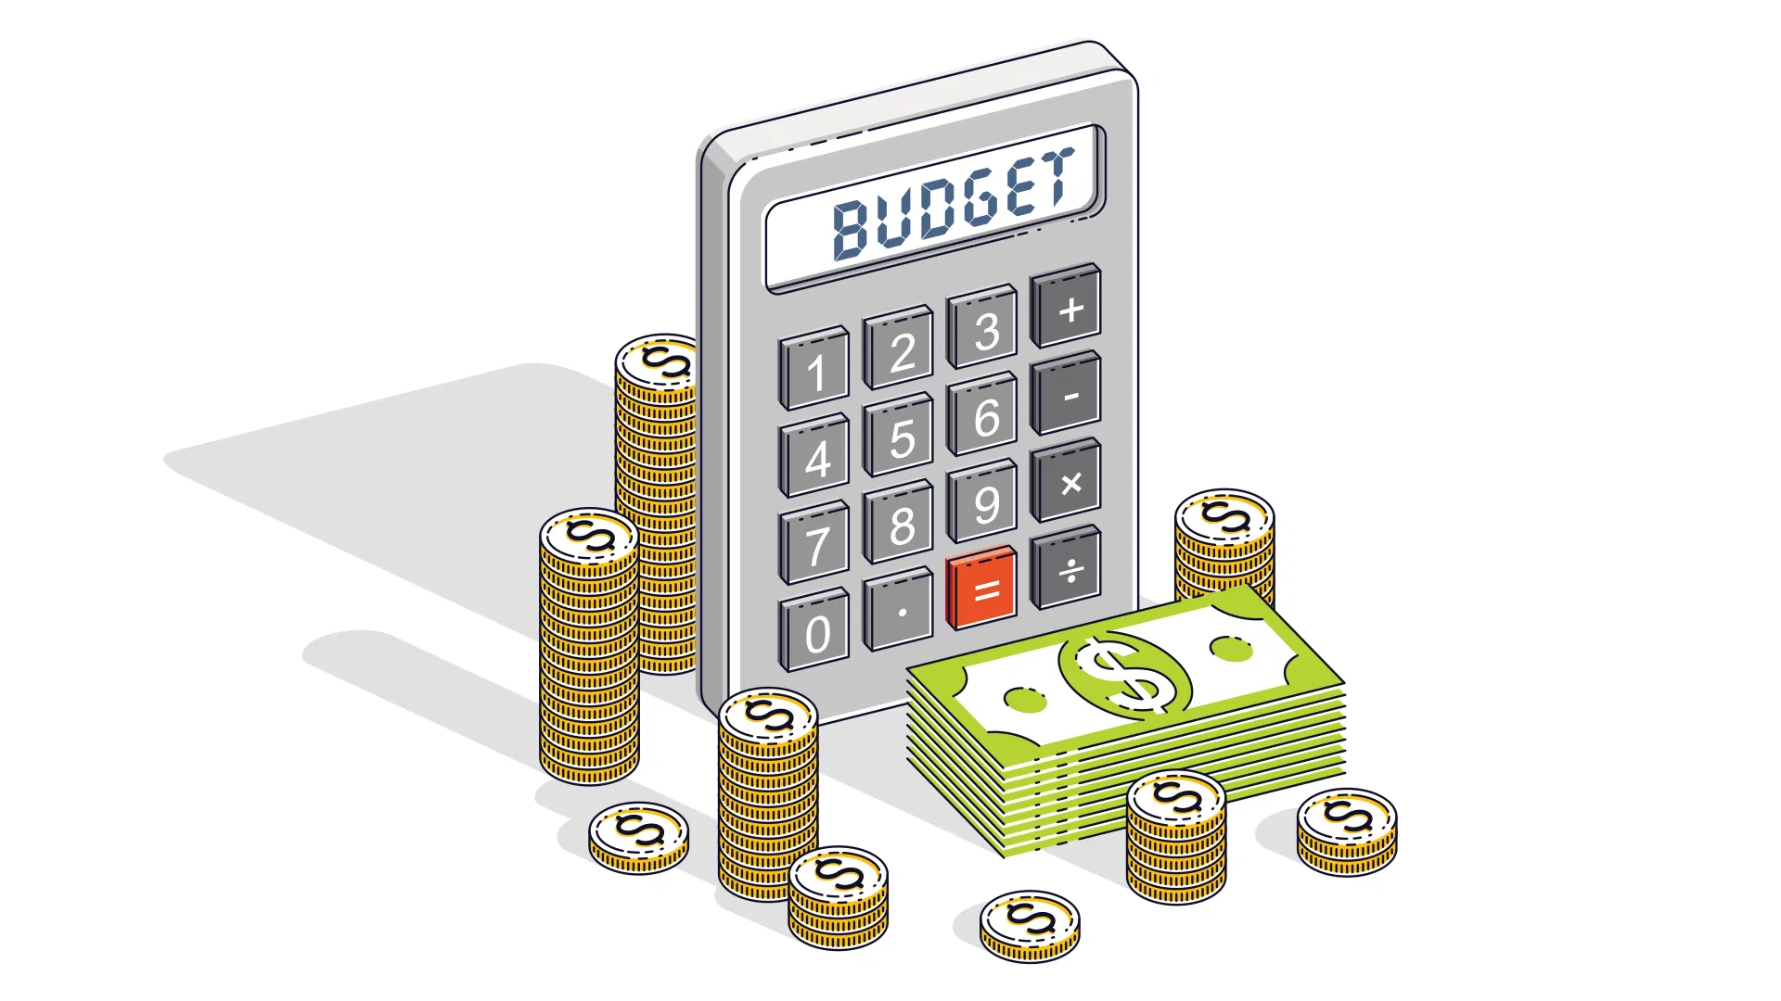
Multi-stepped, multi-budgets, multiple forms
Grantee requests funds through a budget/budget revision done once award is received
Initial Budgets: one for each type of program in which a grant was awarded for
Forms include: PD budget, breakdown of salaries & benefits to be paid, and a budget narrative
Notes:
Budgeting for AE grants is a multi-step process and involves not only multiple forms, but budgets have to be created at least two times in the application process: once with the (re)application where the grantee requests funding and again after grant awards are made to align budgets to award amounts.
Initial budgets must be made for Adult Education, Corrections, and IELCE grants so programs with multiple award types have to create multiple budgets.
Along with the budget are multiple other supporting budget related documents, such as a plan for professional development, salaries & benefits to be paid off the grant, and a budget narrative which are all discussed on subsequent slides.

Slide 25
Administration & Professional Development
Administration
Professional Development
Instruction
Instruction includes:
Admin Salaries & Benefits
Support Staff Salaries & Benefits
Admin Materials & Supplies
Space/Rent
Purchased Services
Indirect Costs
Dues and Registration
Staff Travel
In-service/local training
Taskforce Special Project
Contracted Services-training
Instructional Salaries & Benefits
Classroom Space
Instructional Materials & Supplies
Equipment
Contracted Services (transportation, child care, etc)
Notes:
Budgets are broken down into two main categories: Administration & Professional Development AND Instruction.
Federal legislation (WIOA Sec 222(a)) only allows grantees to utilize 5% of awarded funds for administration and professional development. However, if that amount is not sufficient, programs may request, through a waiver process (See subsequent slide) up to 18% of awarded funds be utilized for Admin & PD.
Administration:
Because of the 5% restriction, programs may have to split a director’s salary & benefits between administration and instruction. How this is done is entirely up to the local program.
Most programs in Wyoming do not have sufficient funds to utilize the budget line items for Support staff, Purchased Services and Space/Rent, so these are typically left blank.
Purchased Services defined:
These are services which by their nature can be performed only by persons or firms with specialized skills and knowledge. While a product may or may not result from the transaction, the primary reason for the purchase is the service provided. Included are the services of auditors, consultants, trainings, etc. Each provider is required to have, at a minimum, an annual financial review conducted by an independent audit firm.
Other Purchased Services
Other purchased services are amounts paid for services rendered by organizations or personnel not on the payroll of the Adult Education program (separate from Professional and Technical Services or Property Services). While a product may or may not result from the transaction, the primary reason for the purchase is the service provided.
Materials & Supplies
Amounts paid for items consumed, worn out, or deteriorated through use; or items that lose their identity through fabrication or incorporation into different or more complex units or substances. Items not contributing to a program’s fixed assets, as evaluated by the provider’s fixed assets policy, may be coded as supply items, or may be coded as non-capital equipment. Items contributing to the program’s fixed assets must be coded as equipment. All computers must be tracked with inventory. Include all supplies, books and periodicals, and electronic media materials here. All books, calculators, and equipment purchased with AE grant funds must be clearly labeled as being purchased with AE grant funds. Labels must be placed on these items that contains the WCCC logo, and the wording “These services are federally funded through the Adult Education program administered by the Wyoming Community College Commission.” (State)
Equipment
Expenditures in this line item include the purchase, lease, or rental of initial equipment, additional equipment, or replacement equipment of $5,000 or greater cost per item. Expenditures are to be used solely for adult education services. These expenditures may be administrative in nature. All items in this category must be clearly explained and detailed in the Budget Detail Sheet. Programs must maintain an up-to-date inventory of equipment.
Indirect Costs (See subsequent slide)
Indirect costs represent the expenses of doing business that are not readily identified with a particular grant, contract, project function or activity, but are necessary for the general operation of the organization and the conduct of activities it performs. Programs that want to have a budget line item must have a pre-established cost rate approved by the Wyoming Dept. of Education AND must have the requested rate approved by the Wyoming Community College Commission before a final budget is submitted.
Note: Because of the restrictions around indirect costs & the 5% cap in Admin & PD, most providers in Wyoming do not utilize the line item for indirect costs.

Slide 26
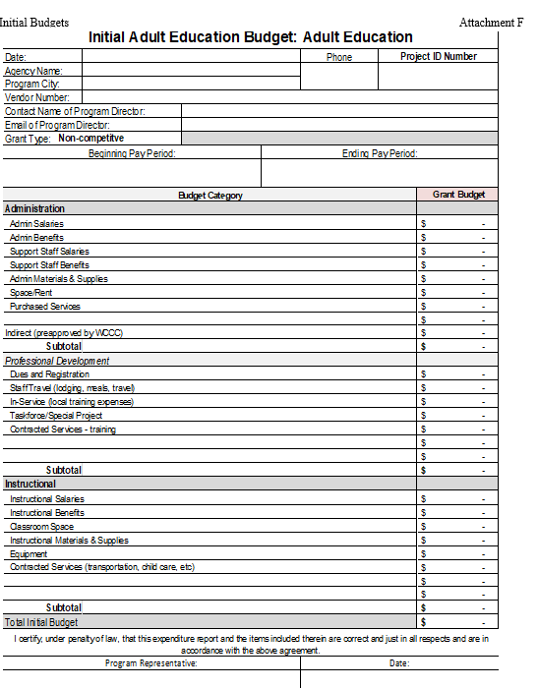
Grantee specific information: Project ID# & Vendor # is provided by the SEA
Pay period is the beginning and ending dates of the grant year
Each line item on the initial budget must match the amount shown for each category on the budget narrative
Copies of budget forms can be found here.

Slide 27
Budget Narrative
Benefits Detail Worksheet
PD Budget Worksheet
Notes:
The budget narrative section consists of one main form and two sub-forms
A budget Narrative details all anticipated grant expenditures including salaries & benefits, materials and supplies, professional development, travel, dues and registration fees, purchased services, classroom or office space, equipment, and contracted services. Indirect costs rate must be pre-approved by WCCC. A letter authorizing the approved indirect cost rate must accompany the budget. The costs of the project should be reasonable in relation to the number of persons to be served and the anticipated outcomes and benefits. Explanations for each line of the full budget are required. Each line item on the budget narrative must match the totals shown on the initial budget for the category.
The sub-forms are briefly discussed below but each are discussed in more detail in subsequent slides.
(1) The Benefits Detail Worksheet which lists by name all individual positions paid a salary and/or benefits from this grant, including their primary position, FTE status, total annual salary and total annual benefits. FTE is the percentage of time a staff member is paid from this project and number of weeks working for the program year. The amounts shown on this worksheet must equal the amounts shown in the narrative for benefits and on the initial budget.
The Professional Development Budget Worksheet is used to describe the details of professional development and training planned for staff that will be paid for using AEFLA funds. Wyoming utilizes a three-tiered approach to PD which is explained in more detail on a subsequent slide. The amounts shown on this worksheet must match the amounts reflected in the narrative itself and on the initial budget form.
Budget narratives are required for EACH type of grant received. If a program receives a Corrections grant, an IELCE grant, and an AE grant, then three budget narratives must be completed. However, programs only need to complete ONE Benefits Worksheet and PD Budget Worksheet as they are planning tools for the entire program.

Slide 28
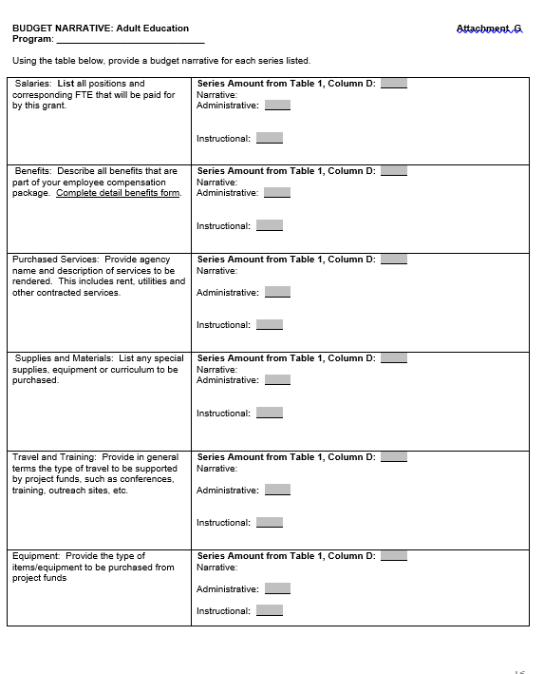
All salaries, positions and their corresponding FTE’s must be identified and itemized in this section
All benefits associated with the positions described in the first category must be listed here. Amounts must match the figures shown on the Benefits Detail Worksheet
Funds for purchased services must identify the agency which will receive the funds and description of what the funds will be used for.
Funds used to purchase materials and supplies are itemized and split between instruction and admin.
Funding for PD and travel to outreach sites is itemized and described in this section. Amounts must match the figures shown on the PD Budget Worksheet
A description of the type of equipment to be purchased must be itemized. Purchases over $500 must be pre-approved by the SEA.
Notes:
Budgeted salary amounts are those funds to be utilized to pay for personnel services for both permanent full and part-time, including personnel substituting for those in permanent positions.

Slide 29
Salaries/Wages
Charges for salaries & wages must be based on records that accurately reflect the work performed These records must:
Be supported by a system of internal control which provides reasonable assurance that the charges are accurate, allowable, and properly allocated.
Be incorporated into the official records of the local program
Reasonably reflect the total activity for which the employee was compensated
Comply with the established accounting policies & practices of the local program
CFR §200.430 (i)(1)
Notes:
Salaries
Amounts paid for personnel services for both permanent full and part-time, including personnel substituting for those in permanent positions. This includes gross salary for personnel services rendered while on the payroll of the school district/college/agency/organization.

Slide 30
Salaries/Wages (Continued)
Charges for salaries & wages must be based on records that accurately reflect the work performed These records must:
Support the distribution of the employee’s salary or ranges among specific activities or cost objectives if the employee works on more than one federal award; a federal ward & non-federal award; an indirect cost activity & and direct cost activity; two or more indirect activities which are allocated using different allocation bases; or an unallowable activity and a direct or indirect cost activity.
Budget estimates alone do not qualify as support for charges to federal awards, but may be use ffor interim accounting purposes.
CFR §200.430 (i)(4)

Slide 31
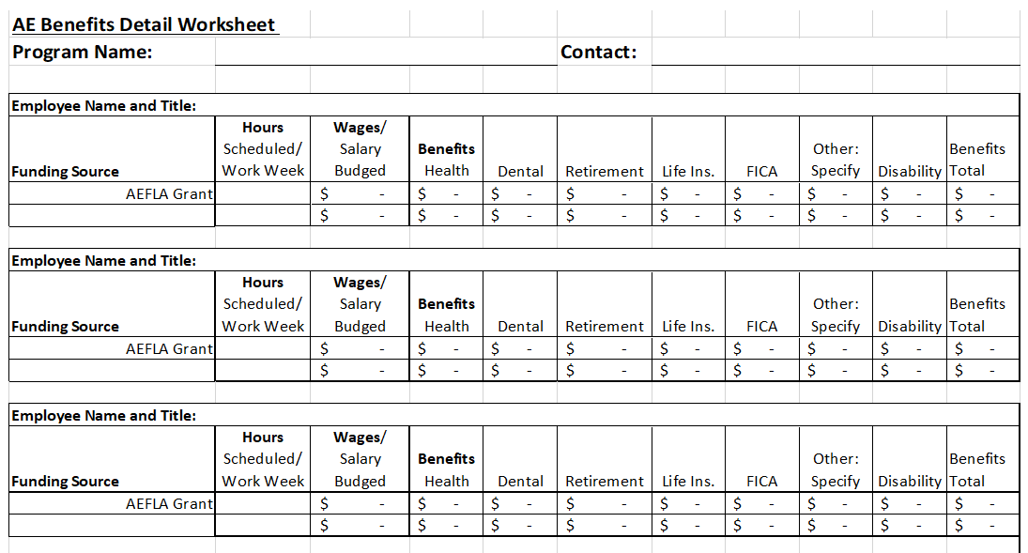
The Benefits Worksheet
Notes:
The Benefits Detail Sheet lists the full benefits received by persons employed in the program and paid for by AEFLA grant funds.
Employee Benefits are amounts paid on behalf of employees; generally, these amounts are not included in the gross salary, but are in addition to salaries. Such payments are fringe benefit payments and, while not paid directly to employees, are part of the cost of personnel services. The benefits for health coverage for full-time benefited employees at community colleges are not to be included on the budget if at least 5% of the salary comes from a non-federal source.

Slide 32
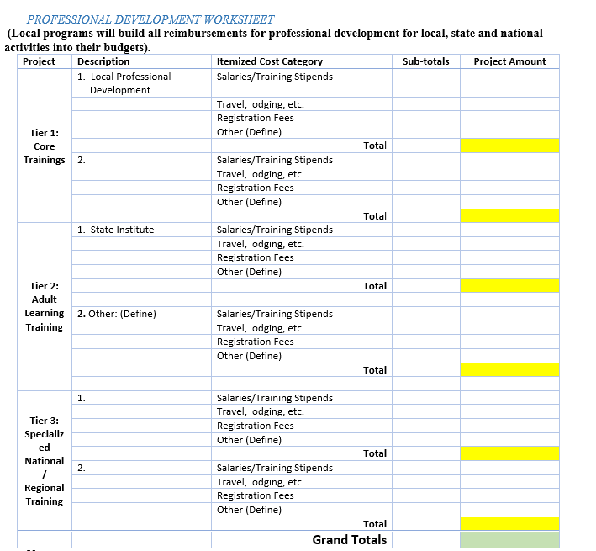
Tier 1 local trainings must occur on a regularly scheduled basis and must include at a minimum:
(at least once per year) assessment level trainings as outlined in the State assessment policy
Career pathways planning
NRS trainings as applicable
Program specific details
Tier 2 State trainings include all State sponsored trainings inclusive of the Summer Institute which requires that 80% of all program staff attend.
Tier 3 trainings include any regional and/or national conferences, trainings that a local program plans for staff.
Notes:
Planning for PD is a three-tiered approach in Wyoming consisting of Tier 1: local trainings, Tier 2: State Trainings, and Tier 3: regional/national trainings. AE programs in Wyoming must plan for all three tiers.
Tier 1 local trainings must occur on a regularly scheduled basis and must include at a minimum:
(at least once per year) assessment level trainings as outlined in the State assessment policy
Career pathways planning
NRS trainings as applicable
Program specific details
Tier 2 State trainings include all State sponsored trainings inclusive of the Summer Institute which requires that 80% of all program staff attend. Programs which do not have at least an 80% attendance rate will be placed on an Action Plan to develop pre-approved professional development opportunities for local staff as a replacement for the Summer Institute.
Tier 3 trainings include any regional and/or national conferences, trainings that a local program plans for staff. Because of limited funding in Wyoming’s AE programs, many providers utilize free resources available such as LINCS, STAR Reading, Teaching Skills That Matter, etc. These types of resources have no costs associated with budgeting, but they should still be clearly defined under the description column so that it is clearly that planning for all three levels has occurred.
The amount shown on the ‘Grand Totals’ line must be equal to the amounts shown in the Budget Narrative and on the Initial Budget for professional development.

Slide 33
Purchasing Materials, Equipment, Office Supplies
Instructional Materials:
Local director approval required
Clearly label materials (when appropriate)
These materials were purchased with AE grant funds available from the WY Community College Commission.
Equipment:
Preapproval required for purchases of $500 or greater
Must be labeled
Maintain inventory
Preapproval required for disposal of all equipment
Notes:
OMB regulations for federal grants stipulate what can/cannot be paid for with grant funds. Because of this, new directors should always consult the State director about major purchases.
Purchasing: materials & supplies/equipment
Programs must use the locally approved purchasing procedures for all purchases. Appropriate records must be kept on file for each purchase.
Instructional materials:
All instructional materials ordered must be approved by the local program director and paid for with the approved
budget line item. This includes books, software, consumables, online licenses, assessments, etc.
All books, consumables and other materials purchased with AE grant funds must be clearly marked as follows:
“These materials were purchased with Adult Education grants funds available from the Wyoming Community College Commission.”
2) Equipment:
The purchase of equipment with a value of $500 or greater must be approved by the State director. “Equipment”
includes furniture, computers, printers, etc. When seeking State director approval of equipment, a written request
along with appropriate documentation is to be submitted. Allow at least two weeks for approval.
An inventory of all equipment with a value of $500 or greater purchased with AE funds must be maintained by the
local Adult Education Program. Each item purchased must be tagged indicating it belongs to Adult Education (as
outlined above). Local programs are required to submit the equipment inventory log within ten days of receipt of the
equipment.
The Disposal/Dropping of Equipment from Inventory is permissible; however, the State office must be contacted and
approval granted before any equipment purchased with Adult Education funds may be disposed of or dropped from
inventory.

Slide 34
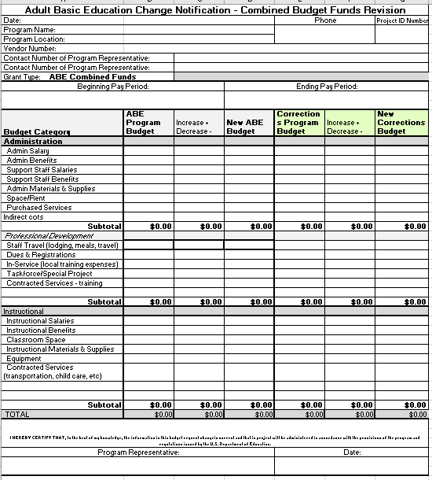
Budget Changes
Budget Change form can be found here.
Notes:
There are times during a year when budgets may need some tweaking to meet unexpected events and demands on staff and materials. A budget can be revised and a Budget Change form is required if the grantee wants to re-budget funds between object codes in an approved budget. Proposed budget changes must be received and approved before adjustments are made. No budget revisions are approved after May 31 of each year.
Funds may be moved from one category to another, but may not be moved within the same category For example, funds may be moved from professional development to instruction but cannot be moved from professional development travel to professional development dues and registration. It is permissible to overdraw a line item in one line item as long as the total for the category is not overdrawn.
Funds may be moved from administration & professional development to instruction BUT cannot be moved from instruction to administration and professional development. Because of this, careful budgeting is required at the beginning of a grant year to ensure that sufficient funds are planned for administration and PD.
When submitted a budget change form each line item in which a budget has been established for must be completed even if there are no changes to that line item. This ensures that the ‘Total’ on the bottom of the form matches grant award amounts. Decreases to a line item should be delineated in red as -$200 (for example) while increases to a line item are denoted in black as +$200.

Slide 35
Cash Match & In-Kind
Cash Match is any funding that pays for AE services and goods. This includes salaries and benefits paid by a third party, professional development paid through another funding stream, facilities, and transportation not paid from the AE grant awarded.
In-kind non federal match is more like a donation of space, custodial services, utilities, technology, printing/copying, etc. that the program does not pay for with awarded funds.

Slide 36
Fair Market Value
=
“What would you pay if it had not been donated?”
Notes:
In-kind funds must utilize fair market value.

Slide 37
To demonstrate that an in-kind contribution or service has been “fairly evaluated”, the provider needs to submit documentation that supports its value.
Examples:
Classroom space: must show actual cost for comparable space in the area, or a real estate appraisal, or cost of renting same space to other organizations
Volunteer’s time: must show value of a paid teacher’s time in the same program

Slide 38
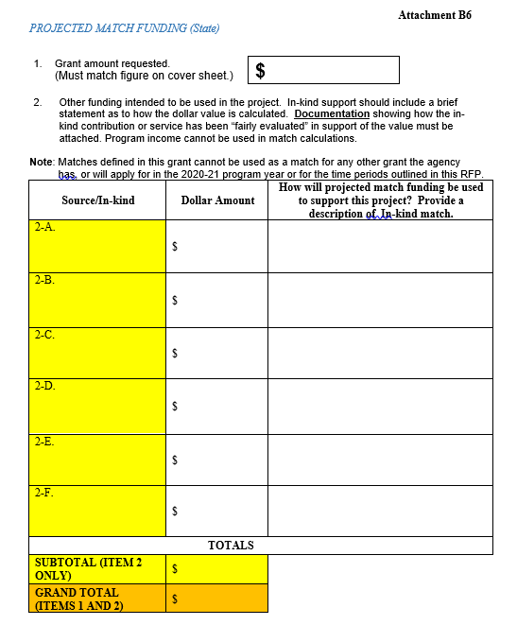
Notes:
Local providers must track cash and in-kind matches for up to 17% of the approved grant award for each year in a grant cycle. These matches help to cover the maintenance of effort required for the state. Matching funds may include expenditures from state, local, and other non-federal sources for adult education programs, services and activities allowable under AEFLA. These matches may be in-kind and/or cash but must be clearly documented on a Match Funding worksheet that is submitted with each competitive grant (shown on the slide)

Slide 39
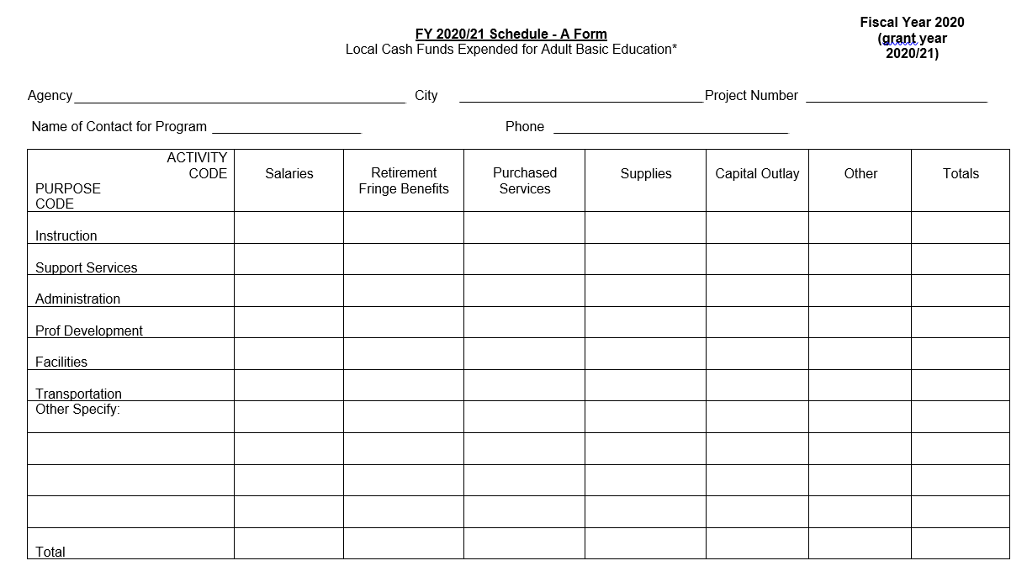
Notes:
At the end of each year, providers must submit a Local Cash Funds Expended form to reflect all Cash Matches made to the Adult Education program in the fiscal year.

Slide 40
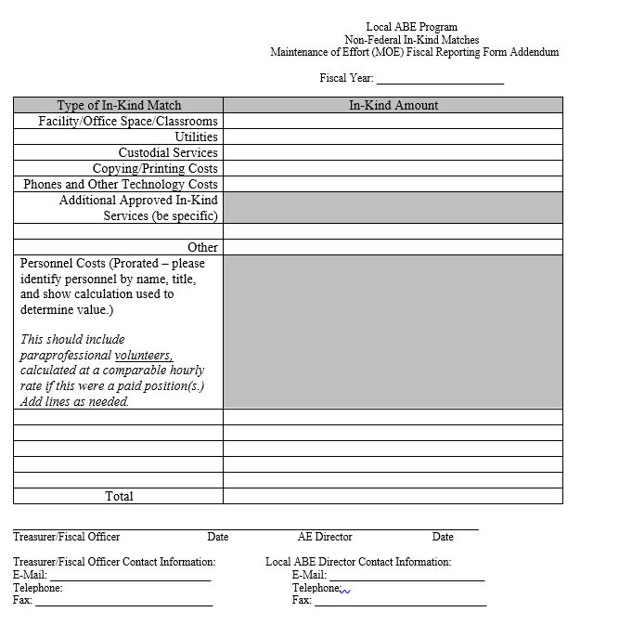
Notes:
Along with the Cash Match form, providers are required to submit (at year’s end) a Maintenance of Effort form for all Non-federal In-Kind Matches made to the program for the fiscal year.

Slide 41
One-Stop Infrastructure Costs
Wyoming’s Infrastructure Agreement: Referrals for WIOA core partners who are not co-located are mandated to make referrals through the One-stop system as an in-kind match to WIOA (463.22(5))
Notes:
The Workforce Innovation and Opportunity Act (WOA) requires that local Workforce Development Board develop a Memorandum of Understanding (MOU) among itself and its required partners that outlines the cost sharing provisions for the operation of the One-Stop system. In Wyoming, this State level Agreement links agency partners through an in-kind referral process from partner agencies and partners to the One-Stop Centers to ensure co-enrollment. Applicants must address how they will fulfill their roles and responsibilities as one-stop partners including supporting one-stops with infrastructure funds, if necessary. (463.22(5))
What this means for providers of AEFLA services in Wyoming is that REFERRALS are critical as they are used as in-kind to meet this federal requirement.

Slide 42
The Drawdown Portal
Approved Budgets
Drawdown Request Submissions
Discussion Board
To access the portal, click here.
Monthly Desk Monitoring Reports
The Drawdown manual can be found here.
Notes:
By the 5th of each month all local providers in Wyoming are required to submit a request to reimburse expended funds. This is known as the drawdown process. Drawdowns are done through a secure portal on the WYCCC’s website. New users are required to request login credentials and should read the drawdown manual that the Commission has put together. This manual is a ‘how to’ manual that explains each portion of the secured portal.
There are several components to the drawdown portal. The first section is where the drawdowns are submitted. Clicking on the ‘draw’ tab takes you to the area where you can request reimbursement for funds expended in the previous month. In this same area you will also see a tab which allows you to see the budget created for the program. This should be an identical copy of the budget submitted as part of the grant application process and/or of budget revisions made.
The portal also offers all directors access to a discussion board where topics/questions/concerns can be posted and discussed as needed.
The final section of the portal that directors will utilize is where all monthly desk monitoring reports and other documents of a secure nature can be uploaded.

Slide 43
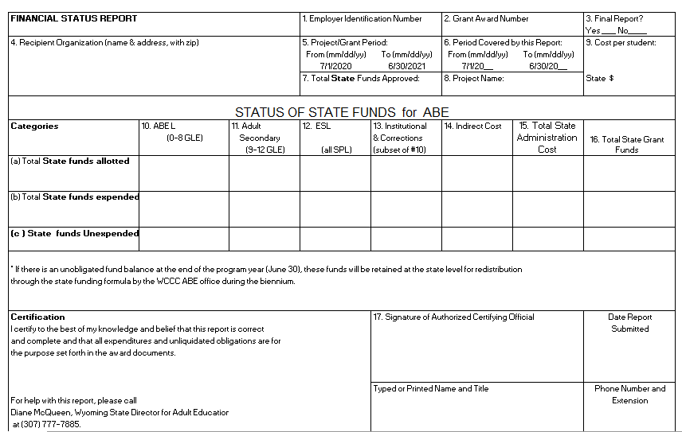
Fiscal Status Reports (FSR)
The State FSR
Instructions on how to complete the FSR’s can be found here.
Notes:
In module 2 we briefly mentioned the FSR’s as a required report for End of Year Reporting. Financial Status Reports
Wyoming’s AE programs have two FSR each year which must be completed. The first is for reporting on state funds. All state dollars received for the AE program and spent for regular allowable AE activities must be reported on the state financial status report form

Slide 44
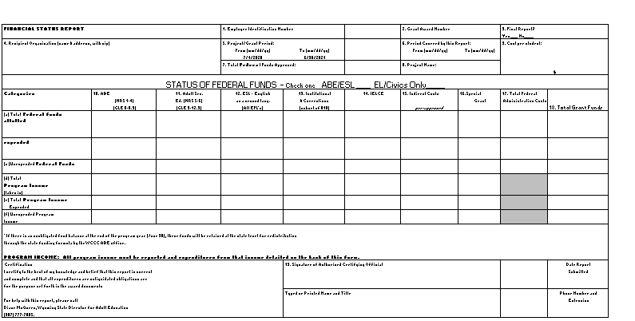
Fiscal Status Report (continued)
The Federal FSR
Wyoming’s FSR templates can be found here.
Notes:
The second FSR is for reporting federal AE grant dollars and is a two page form. All grant dollars received and spent for regular allowable AE activities must be reported on these AE financial status reports.

Slide 45
—Abraham Lincoln
“ You cannot escape the responsibility of tomorrow by evading it today.”

